Slide 1
Introducing to my self

Slide 2
I am Pammy Rakholiya.
I am living in Rajkot.
I am very punctual and like to do my all works throughout the day at right time.
I love to eat simple and healthy food.
I like dancing, reading books, playing and cooking in my spare time.
I never bunk my classes and attend every class. I have many friends however Jahanvi is my best friend.

Slide 3



SWOT
I enjoy to read , cook and listen music to relax my mind.

Slide 4

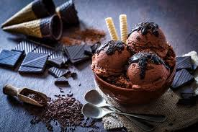
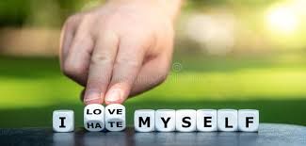


I Loveee ….
my family
Chocolate and ice-cream
Long drive
Natural places

Slide 5

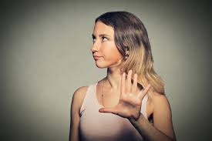

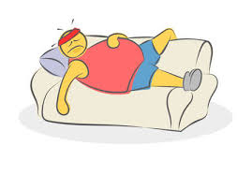
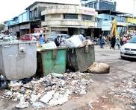
I Hate….
Anger
Attitude person
Lazyness
Dirty places

Slide 6


Slide 7
Thank you

